Slide 1
Introduction

Slide 2
Contents
Recap DDL
Recap DML
Scalar Functions
Aggregate Functions
Joins
Union
Indexes

Slide 3
SQL
Data Manipulation Language (DML) (Later in Course)
Query one or more tables
Insert/delete/modify tuples in tables
Data Definition Language (DDL)
Create/alter/delete tables and their attributes

Slide 4
Data Definition Language (DDL)
Data Definition Language (DDL) is a vocabulary used to define data structures (database schema) in SQL. These statements are used to create, alter, or drop data structures in SQL.
CREATE
DROP
ALTER

Slide 5
SQL DDL Creation Syntax
CREATE TABLE relation-name
(attribute-name domain
[, attribute-name domain ]*)

Slide 6
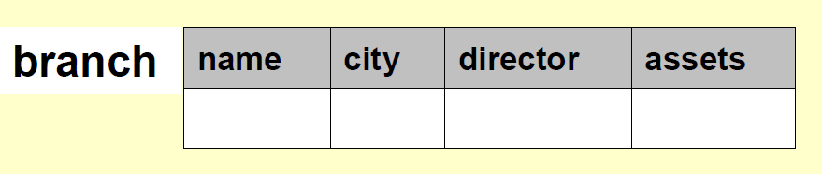
SQL DDL Creation Example
CREATE TABLE branch
( name varchar(10),
city varchar(20),
director varchar(20),
assets integer)

Slide 7
SQL DDL Alteration Syntax
To add an attribute:
ALTER TABLE relation_name
ADD Att Domain
To remove an attribute:
ALTER TABLE relation_name
DROP Att

Slide 8
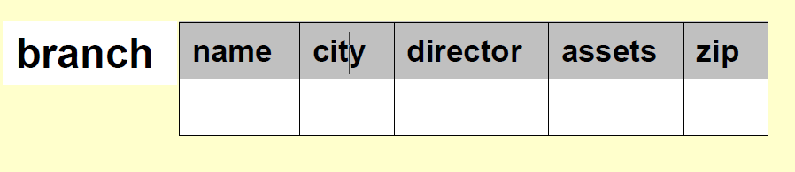
SQL DDL Alteration Example
ALTER TABLE branch ADD zip INTEGER
becomes

Slide 9
SQL DDL Alteration Example
ALTER TABLE branch DROP zip
becomes

Slide 10
SQL
Data Manipulation Language (DML)
Query one or more tables
Insert/delete/modify tuples in tables
Data Definition Language (DDL)
Create/alter/delete tables and their attributes

Slide 11
Data Manipulation Language (DML)
Data manipulation language comprises the SQL data change statements, which modify stored data but not the schema or database objects.
SELECT ... FROM ... WHERE ...
INSERT INTO ... VALUES ...
UPDATE ... SET ... WHERE ...
DELETE FROM ... WHERE ...

Slide 12
The LIKE operator
SELECT * FROM Products WHERE PName LIKE ‘%gizmo%’
s LIKE p: pattern matching on strings
p may contain two special symbols:
% = any sequence of characters
_ = any single character

Slide 13
Eliminating Duplicates
Category
Gadgets
Photography
Household
SELECT DISTINCT category
FROM Product
Compare to:
Category
Gadgets
Gadgets
Photography
Household
SELECT category
FROM Product

Slide 14
SELECT DISTINCT Example
"Persons" table:
P_Id | LastName | FirstName | Address | City
1 | Hansen | Ola | Timoteivn 10 | Sandnes
2 | Svendson | Tove | Borgvn 23 | Sandnes
3 | Pettersen | Kari | Storgt 20 | Stavanger
SELECT DISTINCT City
FROM Persons
City
Sandnes
Stavanger

Slide 15
SQL ORDER BY Keyword
The ORDER BY keyword is used to sort the result-set by a specified column.
The ORDER BY keyword sort the records in ascending order by default.
If you want to sort the records in a descending order, you can use the DESC keyword.
SQL ORDER BY Syntax:
SELECT column_name(s) FROM table_name ORDER BY column_name(s) ASC|DESC

Slide 16
ORDER BY (Default ASC) Example
"Persons" table:
P_Id | LastName | FirstName | Address | City
1 | Hansen | Ola | Timoteivn 10 | Sandnes
2 | Svendson | Tove | Borgvn 23 | Sandnes
3 | Pettersen | Kari | Storgt 20 | Stavanger
SELECT * FROM Persons ORDER BY LastName
P_Id | LastName | FirstName | Address | City
1 | Hansen | Ola | Timoteivn 10 | Sandnes
4 | Nilsen | Tom | Vingvn 23 | Stavanger
3 | Pettersen | Kari | Storgt 20 | Stavanger
2 | Svendson | Tove | Borgvn 23 | Sandnes

Slide 17
SQL Scalar functions
SQL scalar functions return a single value, based on the input value.
Useful scalar functions:
UCASE() - Converts a field to upper case
LCASE() - Converts a field to lower case
LENGTH() - Returns the length of a text field
ROUND() - Rounds a numeric field to the number of decimals specified
NOW() - Returns the current system date and time

Slide 18
SQL Aggregate Functions
SQL has many built-in functions for performing calculations on data.
SQL Aggregate Functions return a single value, calculated from values in a column. Useful aggregate functions:
AVG() - Returns the average value
COUNT() - Returns the number of rows
SUM() - Returns the sum

Slide 19
Recap the DML statements ..
SELECT ... FROM ... WHERE ...
INSERT INTO ... VALUES ...
UPDATE ... SET ... WHERE ...
DELETE FROM ... WHERE ...

Slide 20
Insert Syntax
To insert rows into a table:
INSERT INTO <table name>
VALUES<condition>;

Slide 21
Insert Example
To insert a row into a table, it is necessary to have a value for each attribute, and order matters.
Example: INSERT into FoodCart
VALUES (’02/26/08', ‘pizza', 70 );
FoodCart
Becomes
date
food
sold
date
food
sold
02/25/08
pizza
350
02/25/08
pizza
350
02/26/08
hotdog
500
02/26/08
hotdog
500
02/26/08
pizza
70

Slide 22
Deletion Syntax
To delete rows from the table:
DELETE FROM <table name>
WHERE <condition>;

Slide 23
Deletion Example
DELETE FROM FoodCart
WHERE food = ‘hotdog’;
FoodCart
Becomes
date
food
sold
date
food
sold
02/25/08
pizza
349
02/25/08
pizza
349
02/26/08
hotdog
500
02/26/08
pizza
70
02/26/08
pizza
70
Note: If the WHERE clause is omitted all rows of data are deleted from the table.

Slide 24
Update Syntax
To update the content of the table:
UPDATE <table name>
SET <attr> = <value>
WHERE <selection condition>;

Slide 25
Update Example
UPDATE FoodCart SET sold = 349
WHERE date = ’02/25/08’ AND food = ‘pizza’;
FoodCart
Becomes
date
food
sold
date
food
sold
02/25/08
pizza
350
02/25/08
pizza
349
02/26/08
hotdog
500
02/26/08
hotdog
500
02/26/08
pizza
70
02/26/08
pizza
70

Slide 26
SQL NULL Values
NULL values represent missing unknown data.
By default, a table column can hold NULL values.
If a column in a table is optional, we can insert a new record or update an existing record without adding a value to this column. This means that the field will be saved with a NULL value.

Slide 27
SQL NULL Values
"Persons" table:
P_Id | LastName | FirstName | Address | City
1 | Hansen | Ola |  | Sandnes
2 | Svendson | Tove | Borgvn 23 | Sandnes
3 | Pettersen | Kari |  | Stavanger
Suppose that the "Address" column in the "Persons" table is optional. This means that if we insert a record with no value for the "Address" column, the "Address" column will be saved with a NULL value.
How can we test for NULL values?
It is not possible to test for NULL values with comparison operators, such as =, <, or <>.
We will have to use the IS NULL and IS NOT NULL operators instead.

Slide 28
SQL IS NULL
How do we select only the records with NULL values in the "Address" column?
We will have to use the IS NULL operator:
SELECT LastName,FirstName,Address FROM Persons WHERE Address IS NULL
The result-set will look like this:
LastName | FirstName | Address
Hansen | Ola
Pettersen | Kari

Slide 29
SQL IS NOT NULL
How do we select only the records with no NULL values in the "Address" column?
We will have to use the IS NOT NULL operator:
SELECT LastName,FirstName,Address FROM Persons WHERE Address IS NOT NULL
The result-set will look like this:
LastName | FirstName | Address
Svendson | Tove | Borgvn 23

Slide 30
How to group and summarize data
The GROUP BY clause groups the rows of a result set based on one or more columns or expressions.
Syntax
SELECT column_name, aggregate_function(column_name) FROM table_name WHERE column_name operator value GROUP BY column_name;

Slide 31
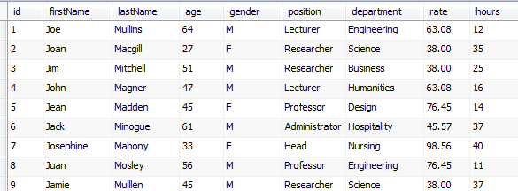

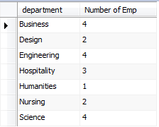
Example using details table

Slide 32

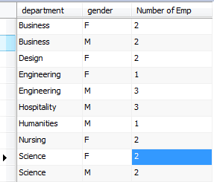
Group By with 2 columns
If you include 2 or more columns or expressions in the GROUP BY clause, they will form a hierarchy where each column or expression is subordinate to the previous one.

Slide 33
Group By and Having Clause
The GROUP BY clause determines how the selected rows are grouped, and the HAVING clause determines which groups are included in the final results

Slide 34


Group By & Having Clause example

Slide 35
Group By & WITH ROLLUP
You can use the WITH ROLLUP operator in the GROUP BY clause to add summary rows to the final result set.

Slide 36
Exercises for details table
What is the average age in each department?
What is the average age of each position?
Count the number of males/females for department – use the WITH ROLLUP to include sub totals per department

Slide 37
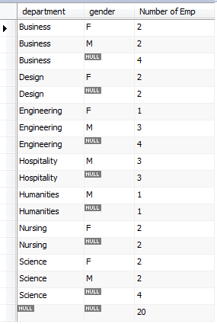
WITH ROLLUP example
select department, gender, count(*) AS "Number of Emp"
from detailslab2.details
group by department, gender WITH ROLLUP;

Slide 38
SQL NOW() Function
The NOW() function returns the current system date and time.
SQL NOW() Syntax:
SELECT NOW()
FROM table_name

Slide 39
SQL NOW() Example
"Products" table:
Prod_Id | ProductName | Unit | UnitPrice
1 | Jarlsberg | 1000 g | 10.45
2 | Mascarpone | 1000 g | 32.56
3 | Gorgonzola | 1000 g | 15.67
SELECT ProductName, UnitPrice, Now() as PerDate FROM Products
ProductName | UnitPrice | PerDate
Jarlsberg | 10.45 | 10/7/2008 11:25:02 AM
Mascarpone | 32.56 | 10/7/2008 11:25:02 AM
Gorgonzola | 15.67 | 10/7/2008 11:25:02 AM

Slide 40
SQL AND Operator
The AND operator is used to filter records based on more than one condition.
The AND operator displays a record if both the first condition and the second condition is true.

Slide 41
AND Example
"Persons" table:
P_Id | LastName | FirstName | Address | City
1 | Hansen | Ola | Timoteivn 10 | Sandnes
2 | Svendson | Tove | Borgvn 23 | Sandnes
3 | Pettersen | Kari | Storgt 20 | Stavanger
SELECT * FROM Persons WHERE FirstName='Tove' AND LastName='Svendson'
_Id | LastName | FirstName | Address | City
2 | Svendson | Tove | Borgvn 23 | Sandnes

Slide 42
SQL OR Operator
The OR operator is used to filter records based on more than one condition.
The OR operator displays a record if either the first condition or the second condition is true

Slide 43
OR Example
"Persons" table:
P_Id | LastName | FirstName | Address | City
1 | Hansen | Ola | Timoteivn 10 | Sandnes
2 | Svendson | Tove | Borgvn 23 | Sandnes
3 | Pettersen | Kari | Storgt 20 | Stavanger
SELECT * FROM Persons WHERE FirstName='Tove' OR FirstName='Ola'
P_Id | LastName | FirstName | Address | City
1 | Hansen | Ola | Timoteivn 10 | Sandnes
2 | Svendson | Tove | Borgvn 23 | Sandnes

Slide 44
Exercise
Get the details of all employees who are not between the ages of 40 and 50, i.e. they are not in their 40s
Try this a few ways
Use OR
Use Like
Use ‘not between’

Slide 45
Subqueries
A subquery is a select-from-where expression that is nested within another query.
When a subquery returns a single value you can use it anywhere you would normally use a single value
When a subquery returns a list of values you can use it anywhere you would normally use a list of values , such as the list for an IN operator - see next example

Slide 46
Example Query
Find all customers who have both an account and a loan at the bank.
select distinct customer_name from borrower where customer_name in (select customer_name from depositor )
Find all customers who have a loan at the bank but do not have an account at the bank
select distinct customer_name from borrower where customer_name not in (select customer_name from depositor )

Slide 47
SQL Joins
SQL joins are used to query data from two or more tables, based on a relationship between certain columns in these tables.
Tables in a database are often related to each other with keys.
Each primary key value must be unique within the table. The purpose is to bind data together, across tables, without repeating all of the data in every table.

Slide 48
SQL Joins
Persons Table:
P_Id | LastName | FirstName | Address | City
1 | Hansen | Ola | Timoteivn 10 | Sandnes
2 | Svendson | Tove | Borgvn 23 | Sandnes
3 | Pettersen | Kari | Storgt 20 | Stavanger
Note: "P_Id" column is the primary key in the "Persons" table. This means that no two rows can have the same P_Id. The P_Id distinguishes two persons even if they have the same name.

Slide 49
SQL Joins
Now Consider the "Orders" table:
O_Id | OrderNo | P_Id
1 | 77895 | 3
2 | 44678 | 3
3 | 22456 | 1
4 | 24562 | 1
5 | 34764 | 15
Note that the "O_Id" column is the primary key in the "Orders" table and that the "P_Id" column refers to the persons in the "Persons" table without using their names.
Notice that the relationship between the Persons and Orders table is the "P_Id" column.

Slide 50
Different SQL JOINs
Before we continue with examples, we will list the types of JOIN you can use, and the differences between them.
JOIN (Also Called Inner Join): Return rows when there is at least one match in both tables
LEFT JOIN(Also called LEFT OUTER JOIN): Return all rows from the left table, even if there are no matches in the right table
RIGHT JOIN(Also called Right OUTER JOIN): Return all rows from the right table, even if there are no matches in the left table
FULL JOIN: Return rows when there is a match in one of the tables

Slide 51
SQL INNER JOIN
The INNER JOIN keyword return rows when there is at least one match in both tables.
SQL INNER JOIN Syntax:
SELECT column_name(s)
FROM table_name1
INNER JOIN table_name2
ON table_name1.column_name=table_name2.column_name

Slide 52
SQL INNER JOIN
Using the Person and Orders Tables we want to list all the persons with any orders.
We use the following SELECT statement:
SELECT Persons.LastName, Persons.FirstName,Orders.OrderNo FROM Persons INNER JOIN Orders ON Persons.P_Id=Orders.P_Id ORDER BY Persons.LastName
The INNER JOIN keyword return rows when there is at least one match in both tables.

Slide 53
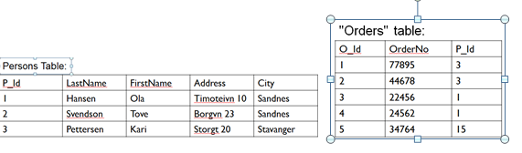
SQL INNER JOIN
The result-set will look like this:
LastName | FirstName | OrderNo
Hansen | Ola | 22456
Hansen | Ola | 24562
Pettersen | Kari | 77895
Pettersen | Kari | 44678
The INNER JOIN keyword returns rows when there is at least one match in both tables. If there are rows in "Persons" that do not have matches in "Orders", those rows will NOT be listed.

Slide 54
SQL LEFT JOIN
The LEFT JOIN (also called LEFT OUTER JOIN) keyword returns all rows from the left table (table_name1), even if there are no matches in the right table (table_name2).
SQL LEFT JOIN Syntax
SELECT column_name(s) FROM table_name1 LEFT JOIN table_name2 ON table_name1.column_name=
table_name2.column_name

Slide 55
SQL LEFT JOIN
Using the Persons and Orders Table we want to list all the persons and their orders - if any, from the tables above.
We use the following SELECT statement:
SELECT Persons.LastName, Persons.FirstName,
Orders.OrderNo FROM Persons LEFT JOIN Orders ON Persons.P_Id=Orders.P_Id ORDER BY Persons.LastName
The LEFT JOIN keyword returns all the rows from the left table (Persons), even if there are no matches in the right table (Orders).

Slide 56
SQL LEFT JOIN
The result-set will look like this:
LastName | FirstName | OrderNo
Hansen | Ola | 22456
Hansen | Ola | 24562
Pettersen | Kari | 77895
Pettersen | Kari | 44678
Svendson | Tove
The LEFT JOIN keyword returns all the rows from the left table (Persons), even if there are no matches in the right table (Orders).

Slide 57
SQL RIGHT JOIN
The RIGHT JOIN (Sometimes called RIGHT OUTER Join) keyword returns all the rows from the right table (table_name2), even if there are no matches in the left table (table_name1).
SQL RIGHT JOIN Syntax
SELECT column_name(s) FROM table_name1 RIGHT JOIN table_name2 ON table_name1.column_name=
table_name2.column_name

Slide 58
SQL RIGHT JOIN
Now we want to list all the orders with containing persons - if any, from the tables above.
We use the following SELECT statement:
SELECT Persons.LastName, Persons.FirstName, Orders.OrderNo FROM Persons RIGHT JOIN Orders ON Persons.P_Id=Orders.P_Id ORDER BY Persons.LastName
The RIGHT keyword returns all the rows from the right table even if there are no matches in the left table.

Slide 59
SQL RIGHT JOIN
The result-set will look like this:
LastName | FirstName | OrderNo
Hansen | Ola | 22456
Hansen | Ola | 24562
Pettersen | Kari | 77895
Pettersen | Kari | 44678
 |  | 34764
The RIGHT JOIN keyword returns all the rows from the right table (Orders), even if there are no matches in the left table (Persons).

Slide 60
SQL FULL JOIN
The FULL JOIN keyword return rows when there is a match in one of the tables.
SQL FULL JOIN Syntax:
SELECT column_name(s) FROM table_name1 FULL JOIN table_name2 ON table_name1.column_name=
table_name2.column_name
FULL JOIN table_name2 ON table_name1.column_name=table_name2.column_name

Slide 61
SQL FULL JOIN
Now we want to list all the persons and their orders, and all the orders with their persons.
We use the following SELECT statement:
SELECT Persons.LastName, Persons.FirstName, Orders.OrderNo FROM Persons FULL JOIN Orders ON Persons.P_Id=Orders.P_Id ORDER BY Persons.LastName
The FULL JOIN keyword returns all the rows from the left table (Persons), and all the rows from the right table (Orders).

Slide 62
SQL FULL JOIN
The result-set will look like this:
LastName | FirstName | OrderNo
Hansen | Ola | 22456
Hansen | Ola | 24562
Pettersen | Kari | 77895
Pettersen | Kari | 44678
Svendson | Tove
 |  | 34764
The FULL JOIN keyword returns all the rows from the left table (Persons), and all the rows from the right table (Orders). If there are rows in "Persons" that do not have matches in "Orders", or if there are rows in "Orders" that do not have matches in "Persons", those rows will be listed as well.

Slide 63
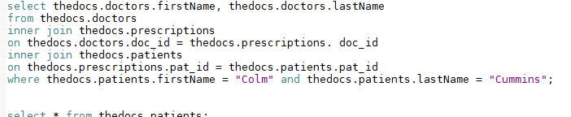
Another SQL join
Run this example
This example shows the names of the doctors who wrote prescriptions for Colm Cummins.

Slide 64
Union
The UNION operator is used to combine the result-set of two or more SELECT statements.
Each SELECT statement within UNION must have the same number of columns
The columns must also have similar data types
The columns in each SELECT statement must also be in the same order

Slide 65
Union
SELECT column_name(s) FROM table1 UNION SELECT column_name(s) FROM table2;

Slide 66
Union
Try some examples from W3schools
https://www.w3schools.com/sql/sql_union.asp

Slide 67
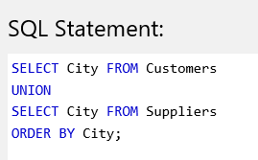
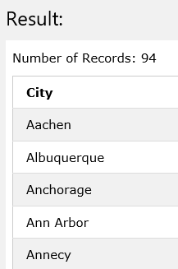
W3schools example

Slide 68
Index

Slide 69
Index
An index speeds up joins and searching by providing a way for a database management system to go directly to a row rather than having to search through all the rows until it finds the one you want.
MySQL automatically creates an index for primary key, foreign key, and unique constraints

Slide 70
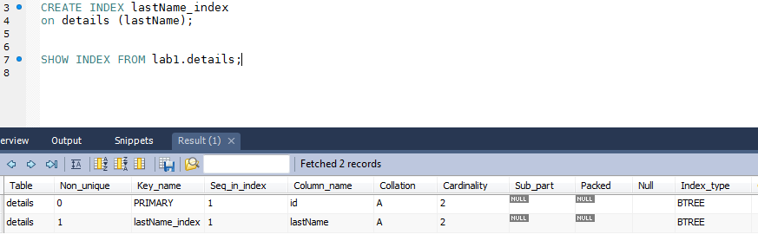
CREATE INDEX
You can use the CREATE INDEX statement to create other indexes for a table.
SHOW INDEX FROM table_name

Slide 71
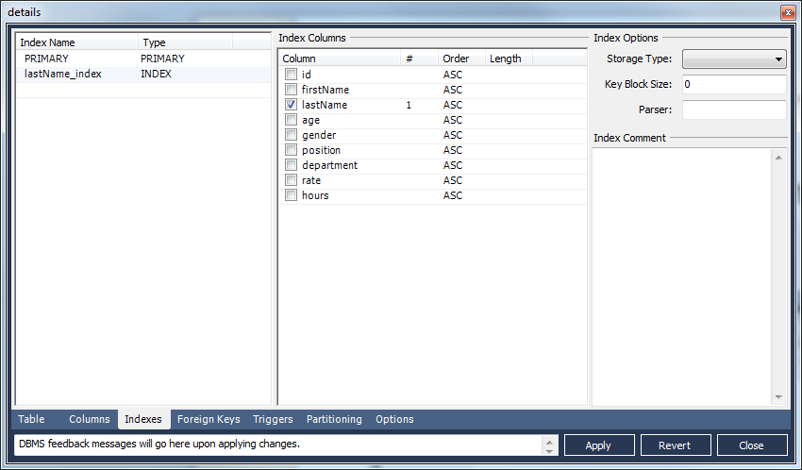
Show index from the workbench
Right click on the table and select the Alter Table command

Slide 72
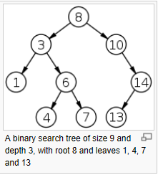
Index Type
BTREE – a type of binary search tree
The B-tree is optimized for systems that read and write large blocks of data. It is commonly used in databases and file systems.

Slide 73
DROP INDEX
You can use the DROP INDEX statement to drop an index from a table.
DROP INDEX index_name ON table_name
You may want to create indexes for columns that are used frequently in search conditions or joins.
You will want to avoid creating indexes on columns that are updated frequently since this slows down the insert, update and delete operations.

